Slide 1
America’s History
Chapter 25-
Early Cold War

Slide 2
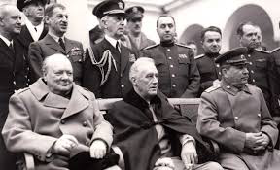
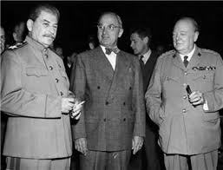

Containment and a Divided Global Order
Origins of the Cold War
  Is the enemy of your enemy, your friend, or your enemy?
Yalta:
  Last meeting of the “Big 3”
  Stalin promised “free and unfettered elections” in Poland at a later date
  Germany was divided into 4
  United Nations (UN) was agreed upon
Potsdam:
  Truman replaced FDR at the Potsdam Conference
  Stalin did not allow self-determination in Eastern Europe
  Churchill’s “Iron curtain” speech

Slide 3
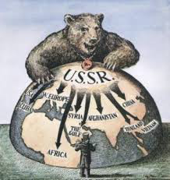
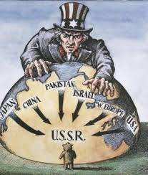
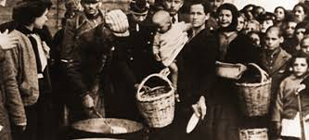
Containment and a Divided Global Order
The Containment Strategy
  3 issues that concerned Truman:
    Soviet Union wanted access to oil in Iran, and the Mediterranean through Turkey
    Civil War in Greece - monarchists vs. communist party
    Communist parties increased in popularity as the economy of Europe suffered

Slide 4
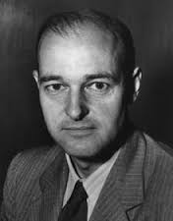
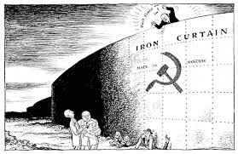
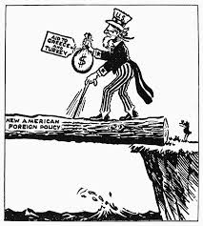
Containment and a Divided Global Order
Toward an Uneasy Peace:
  **George F. Kennan** - urged the Containment of the Soviet Union through counterforce
  Truman Doctrine - Provided $400 million in aid to Greece and Turkey to resist communism
  Marshall Plan - $13 billion to help rebuild war-torn Europe; hoped to make communism less appealing in Europe
  The Soviet Union rejected the aid and forbade Eastern European countries from receiving aid as well

Slide 5
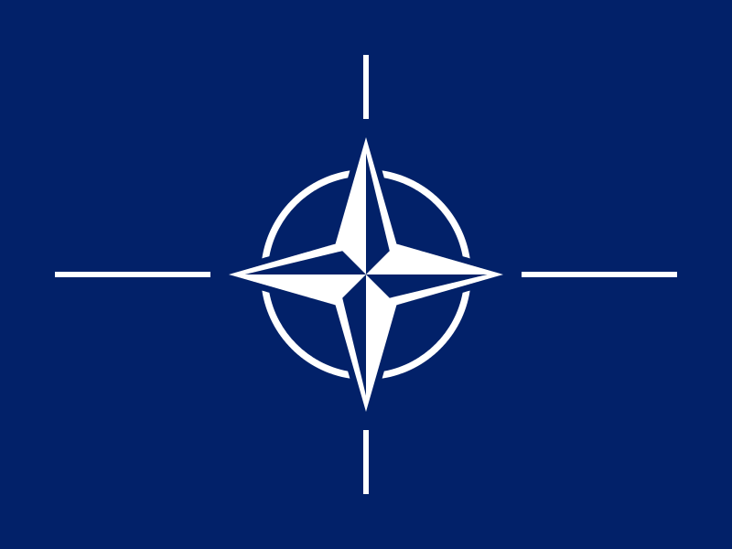
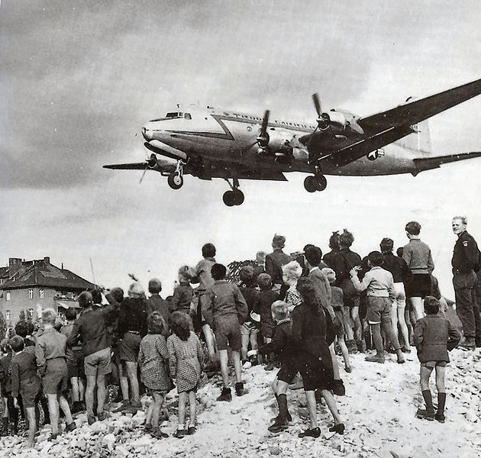
Containment and a Divided Global Order
The Containment Strategy
East and West in the New Europe:
  Berlin Blockade (June, 1948) -> Berlin Airlift
  North Atlantic Treaty Organization (NATO) - peace time alliance, “an attack on one is an attack on all”
  The Soviet Union responded later with the Warsaw Pact
NSC-68:
  Painted the USSR more starkly than Kennan
  Led to a drastic buildup of the military

Slide 6
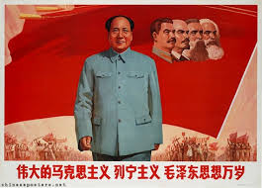
Containment and a Divided Global Order
Containment in Asia
Civil War in China:
  Communists (Mao) vs. Nationalists (Jiang)
  Truman eventually cut off aid to Jiang and Mao and the Communists took control
  Truman was blamed for “losing” China

Slide 7
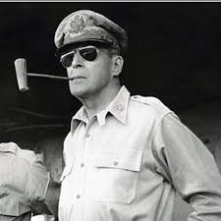
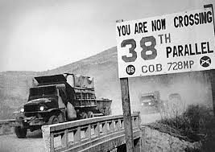
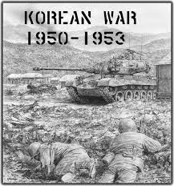
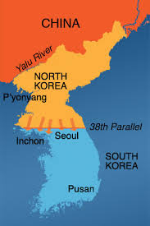
Containment and a Divided Global Order
The Korean War:
  Korea was divided at the 38th parallel, USSR supported the North, US the South
  North Korea attacked the South in June, 1952
  Truman fired General MacArthur for criticizing the war
  War fought without Congressional approval; desegregated units
  The War ended with Eisenhower’s administration

Slide 8
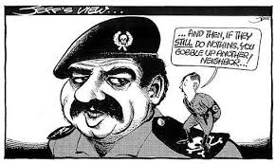
Containment and a Divided Global Order
The Munich Analogy:
  Fear of “appeasing” Russian leaders was a powerful motive for US presidents

Slide 9
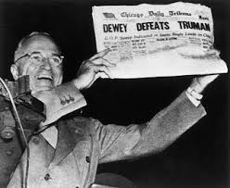
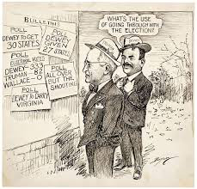
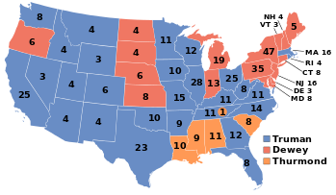
Cold War Liberalism
Truman and the End of Reform
  Cold War Liberalism - preservation of New Deal programs, as well as a containment policy
  Many union members went on strike post-WWII
  Taft-Hartley Act - outlawed the “closed shop”, allowed right-to-work laws
    Non-union members could work in union jobs
The 1948 Election:
  The Democratic Party was split
  “Dixiecrats” nominated Strom Thurmond on a segregationist platform
  Harry Truman defeats Dewey in an upset

Slide 10

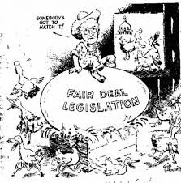
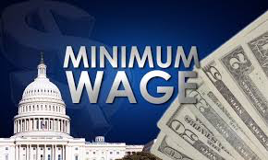

Cold War Liberalism
The Fair Deal:
  Proposed national health insurance, money for education, increased Social Security, and raising the minimum wage
  Most of his proposals were rejected

Slide 11
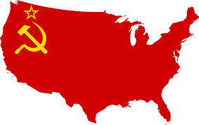
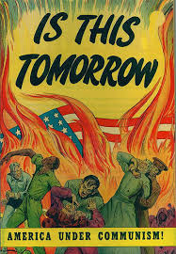
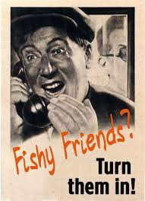
Cold War Liberalism
Red Scare: The Hunt for Communists
  Some government employees and aides to FDR provided the Soviet Union with information
Loyalty-Security Program:
  Executive Order 9835 - government employees could be investigated for subversive activity
HUAC:
  House Un-American Activities Committee:
    Richard Nixon was a prominent member
    Held public hearings on suspected communists
    “Hollywood Ten”
    Alger Hiss - convicted of perjury, spent five years in jail

Slide 12
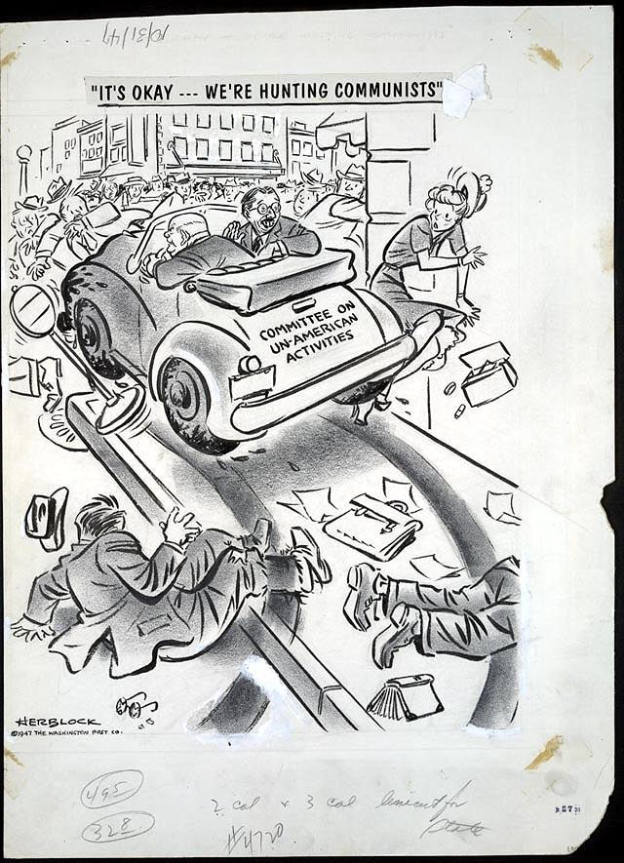
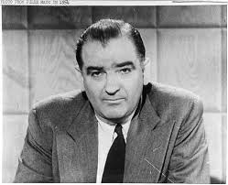
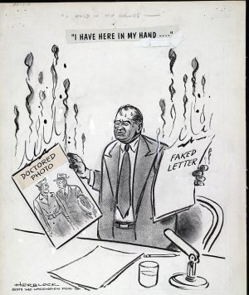
Cold War Liberalism
McCarthyism:
  Accused over 200 government officials of being communist party members
  His charges were often aimed at Democrats
  McCarthy’s downfall came when he attacked the US military, seen as a bully

Slide 13
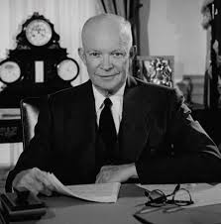
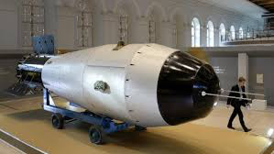
Cold War Liberalism
The Politics of Cold War Liberalism
  “Modern Republicanism” - moderating New Deal programs
  Eisenhower was a moderate
America Under Eisenhower:
  “New Look” defense policy - increased military buildup (hydrogen bomb, bombers)
  Massive Retaliation - US would respond with more force if attacked

Slide 14
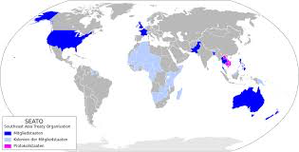
Containment in the Postcolonial World
Revolutions in Third World countries were often regarded as pawns of the Soviet Union
The Cold War and Colonial Independence
  Southeast Asia Treaty Organization (SEATO) - Asian NATO
  Truman and Eisenhower sometimes supported repressive governments, as long as they were anticommunist
  CIA overthrew Mohammad Mossadegh that was elected in Iran, and Jacob Arbenz Guzman in Guatemala

Slide 15
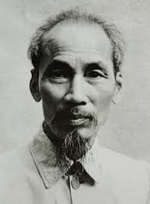
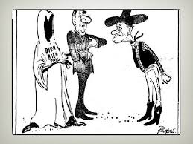
Containment in the Postcolonial World
Vietnam:
  Vietnam was once a French colony
  Ho Chi Minh, a communist, sought to unite Vietnam
  Dien Bien Phu - French defeat in 1954, left Vietnam, US increased its presence

Slide 16
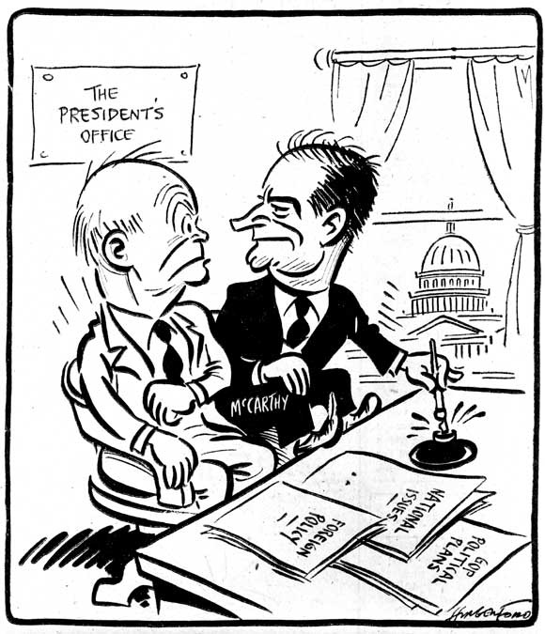
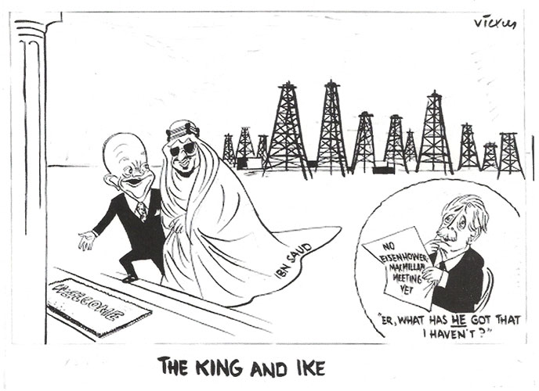
Containment in the Postcolonial World
The Middle East:
  US recognized Israel almost immediately
  Egyptian President Nasser nationalized the Suez Canal, Britain and France attacked, Eisenhower helped end the conflict
  Eisenhower Doctrine - US would help countries in the Middle East that resisted communism

Slide 17
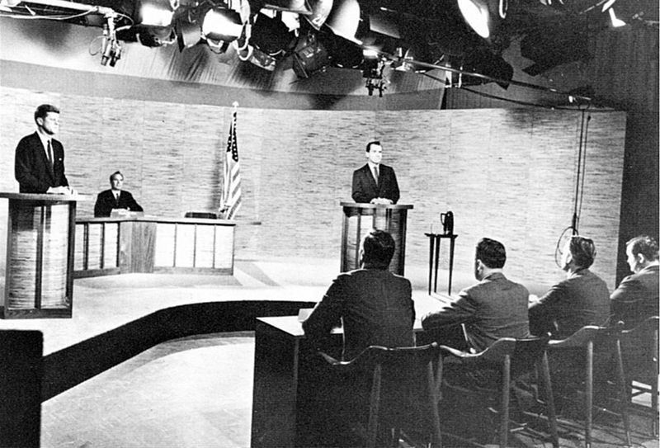
Containment in the Postcolonial World
John F. Kennedy and the Cold War
The Election of 1960 and the New Frontier:
  1960 debates - JFK “won” to those that watched on tv, Nixon “won” to those that listened
  JFK won in a close election
  “New Frontier” - called for advancements in science and Americans to achieve their fullest

Slide 18
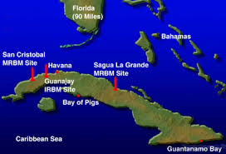
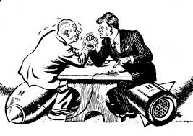
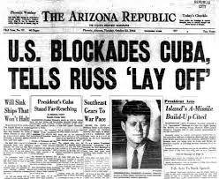
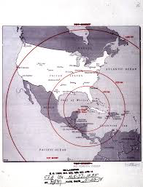
Containment in the Postcolonial World
Crisis in Cuba and Berlin:
  Fidel Castro overthrew Batista in 1959
  Bay of Pigs - CIA operation to try to overthrow Castro in 1961, huge failure
  Khrushchev began construction of the Berlin Wall in 1961 to keep East Berliners from fleeing
  October, 1962 - Cuban Missile Crisis - closest the two sides came to war
    US agreed to remove missiles from Turkey, USSR promised to remove missiles from Cuba

Slide 19
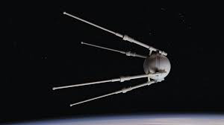
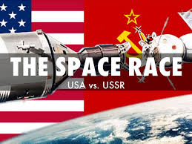
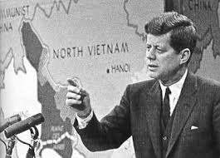
Containment in the Postcolonial World
Kennedy and the World:
  Peace Corps - 2 year commitment by Americans to volunteer in third world regions
    Teaching, social, and economic development
    Hoped to promote America and democracy
  1957 - Sputnik and April 12, 1961 - Yuri Gagarin
    Led to increased spending by US government on science and education
Making a Commitment in Vietnam
  JFK increased military aid to South Vietnam
  Special forces trained South Vietnamese troops
  South Vietnam was led by Diem, a corrupt leader

Slide 20
The Recap
Truman Doctrine and Marshall Plan
Berlin Airlift
NATO
Korean War
1948 Election
McCarthyism and the 2nd Red Scare
The Cold War and Eisenhower
The Election of 1960
Cuba

